Slide 1
Assembly Language (Lab 9)
MUL&& DIV

Slide 2
Agenda
Multiplication
Division
Hands On
Array Multiplication
Get Factors

Slide 3
Multiplication

Slide 4
MUL/IMUL
MUL/IMUL r/m8 | r/m16 | r/m32
Only one Operand ?!!
What is the difference between SHL & MUL?

Slide 5
What is the difference between SHL & MUL?
SHL, is concerned in multiplication by power of twos ONLY
MUL, can multiply by any number (Generic)

Slide 6
Only one operand? … YES
The instructions take only one operand which is the multiplier
Notes: 3*5
The multiplicand is assumed to be stored in specific register
Also, operation results will be stored in specific register(s) not in the given operand.
The locations of the second operand (multiplicand) and operation result differ according to the size of the given operand
multiplier
multiplicand

Slide 7
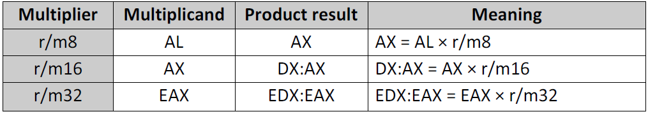
Operand Sizes
The registers holding the product are twice the size of multiplicand and the multiplier, guaranteeing that overflow will never occur.
The product value is divided into two halves: upper and lower. The upper half is AH, DX, and EDX in case if the product value is AX, DX:AX, and EDX:EAX respectively
(MUL) Overflow (OF) and carry (CF) flags are set if the upper half is not equal to zero.
(IMUL) Overflow and carry flags are set if the upper half is not sign-extension of the lower half of product.

Slide 8
Exercise
mov AL, 5
mov BL, 10
mul BL
;AX = 0032h = (50)₁₀, CF = 0
mov AL, 50
mov BL, 10
mul BL
;AX = 01F4h = (500)₁₀, CF = 1
8

Slide 9
Exercise
+192
SBYTE Range
+127 To -128
;AX = 00C0 = (+192)₁₀, OF = 1
;Note that +192 does not fit in AL (lower half of product) as a signed integer, so OF=1
mov AL, 48
mov BL, 4
imul BL
;AX = FFF0 = (-16)₁₀, OF = 0
;Note that even AH (upper half of product)is not equal to zero but it is just sign-
;extension for AL, so OF=0
mov AL, -4
mov BL, 4
imul BL
Notes:
C0 = 1100,0000
But the AX = 0000,0000,1100,0000 Upper half has !Lower half sign so the OF = 1

Slide 10
Array Multiplication
Write an assembly program that reads 5 numbers from users and read a new number to multiply the array by it
Sample Run
Solution: MulArray.asm
Enter numbers: 1 2 3 4 5
Enter a multiplier: 2
Result = 2 4 6 8 10

Slide 11
Division

Slide 12
DIV & IDIV
DIV/IDIV r/m8 | r/m16 | r/m32
Where r/m8 means 8-bit register or memory byte, r/m16 means 16-bit register or memory word, and r/m32 means 32-bit register or memory double word.

Slide 13
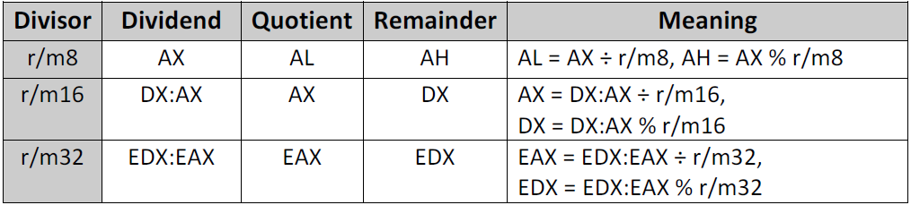
Operand Sizes
The registers holding the quotient are half the size of dividend, assuming result value will be smaller enough to fit in the register… BUT
This assumption is not always true

Slide 14
DIV & IDIV Quirks
If the quotient is too large to fit into destination operand, a division overflow error occurs causing the current program halts!
If the divisor is zero, an integer divide by zero error occurs causing the current program halts!
A very common mistake is to forget to initialize DX or EDX before use 16-bit or 32-bit division.

Slide 15
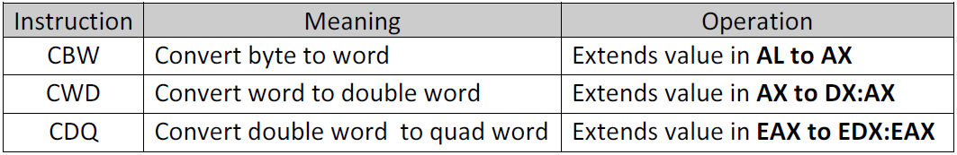
Key Inst.
In IDIV instruction, which used in signed division, dividend should be well initialized to preserve the sign of dividend. There are three instructions extends the sign bit in AL, AX, and EAX to AX, DX, and EDX respectively

Slide 16
Exercise
;Even 82 fit in AL, you should MOV it in AX to initialize AH too
;AL (quotient) = 20,
;AH (remainder) = 2
MOV AX, 82
MOV BL, 4
DIV BL
MOV DX, 0
MOV AX, 82
MOV BX, 4
DIV BX
;As we use 16-bit division, we should initialize DX too
;AX (quotient) = 20,
;DX (remainder) = 2

Slide 17
Exercise
;We have to extend the sign to AX
;AL(quotient)= CEh = -50,
;AH (remainder) = 0
MOV AL, -100
CBW
MOV BL, 2
IDIV BL
MOV AX, -100
MOV BL, 2
IDIV BL
;Instead of use of CBW, move -100 to AX directly
;AL(quotient)= CEh = -50,
;AH (remainder) = 0

Slide 18
Exercise
;AX = 00C8h, DX = ?
;DX:AX = 0000h:00C8h
;AX (quotient) = 50,
;DX (remainder) = 0
MOV AX, 200
MOV BX, 4
CWD
IDIV BX
MOV AX, 1000H
MOV BL, 10H
DIV BL
;ERROR: Integer overflow (100h doesn’t fit in AL)

Slide 19
Get Factors
Write an assembly program that calculates the factor of a given number.
Sample Run
Solution: GetFactors.asm
Enter a number: 6
Factors: 1 2 3 6

Slide 20
Hands On
You Must Use PROC in Your Solution…

Slide 21

The Power of The Sequence
Write an assembly program that calculates the power of an input sequence (array) according to the following formula:
${n1}^{i+1}$, ${n2}^{i+2}$, ${n3}^{i+3}$, ${n4}^{i+4}$, …… $N^{3}$ $i:(0, N)$
Where $i$ is the index of the element in the array.
$N$ is the size of the array
Sample Run
Enter the size of the sequence: 5
Enter sequence elements: 1 2 3 4 5
Power of the sequence:
1 4 27 256 625

Slide 22
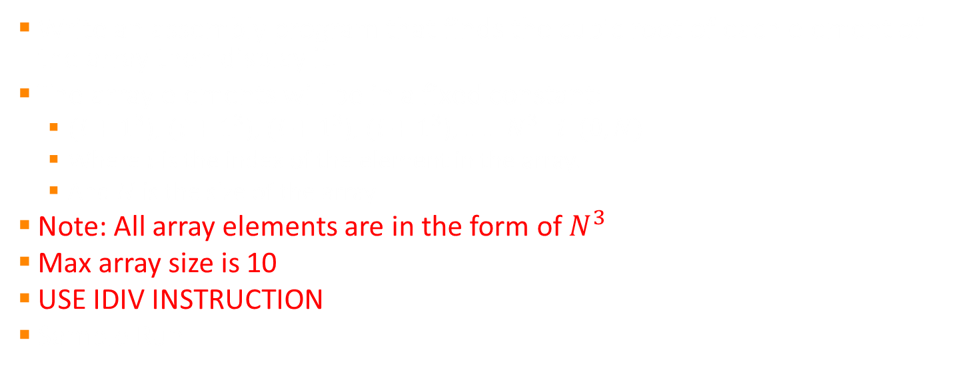
Cubic Root of an Array
Write an assembly program that finds the cubic root of each element of the array then display it.
The array elements will be in a fixed constant:
${(i+1}^{3}$), ${(i+1}^{3}$), ${(i+1}^{3}$), ${(i+1}^{3}$), …… $N^{3}$ $i:(0, N)$
Where $i$ is the index of the element in the array.
And $N$ is the size of the array
Note: All array elements are in the form of $N^{3}$
Max array size is 10
USE IDIV INSTRUCTION
Sample Run
Enter the size of the array: 10
Enter array elements: 1 8 27 64 125 216 343 512 729 1000
Cubic root of the array:
1 2 3 4 5 6 7 8 9 10

Slide 23
Questions?!

Slide 24
Thanks!

